Slide 1


Slide 2
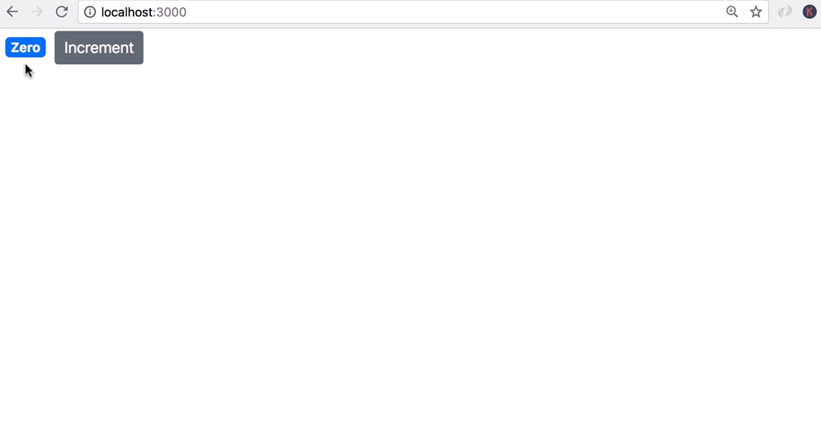

Slide 3
done next we're going to look at rendering classes dynamically
our badge is currently blue but let's change this application
such that if the value of the count property is zero we want to render this as yellow to indicate some kind of warning
otherwise we want to render it as blue

Slide 4
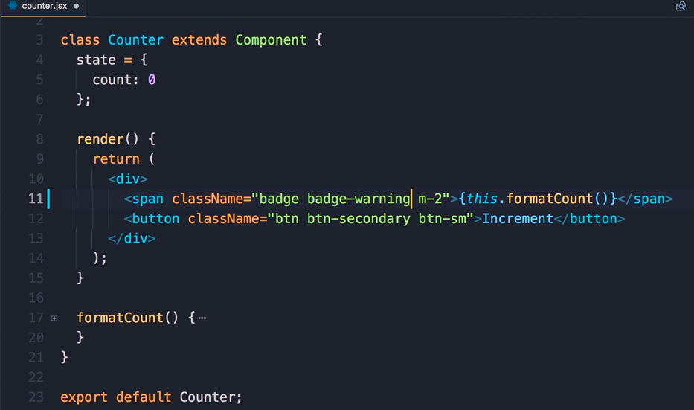

Slide 5
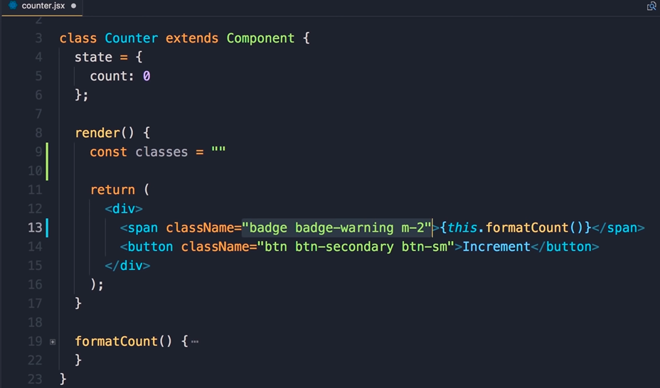

Slide 6
so back in the code let me use the badge primary class here we get a blue badge if we use badge warning we'll get a yellow badge so in this lecture we want to render in one of these classes dynamically depending on the value of the count property
and this is a pattern that you see a lot in real-world applications so here's one way to do this we can define a constant here call it classes set it to a string in this string we're going to include all the classes that we're going to pass here so we start with the primary classes that we want to have in all cases that is badge and m2 so badge and m2 now depending on the value of the count property you want to add badge warning or batch primary to this string so classes plus equal now n

Slide 7
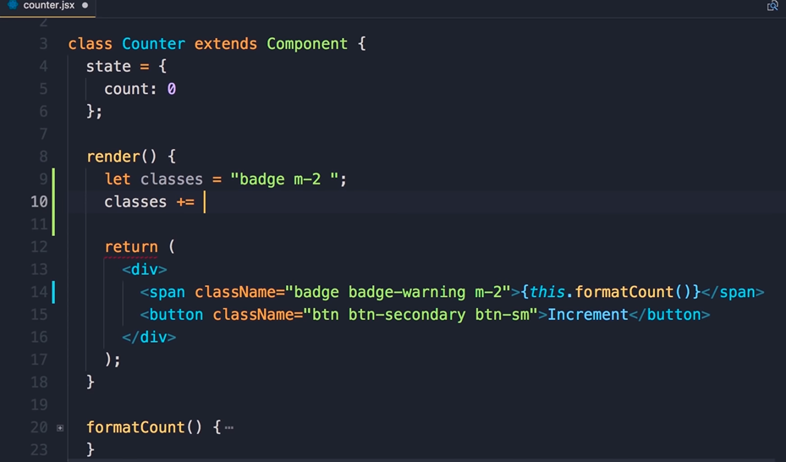

Slide 8
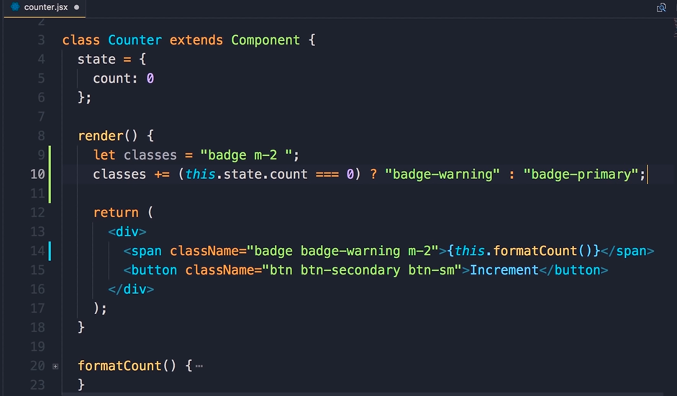

Slide 9
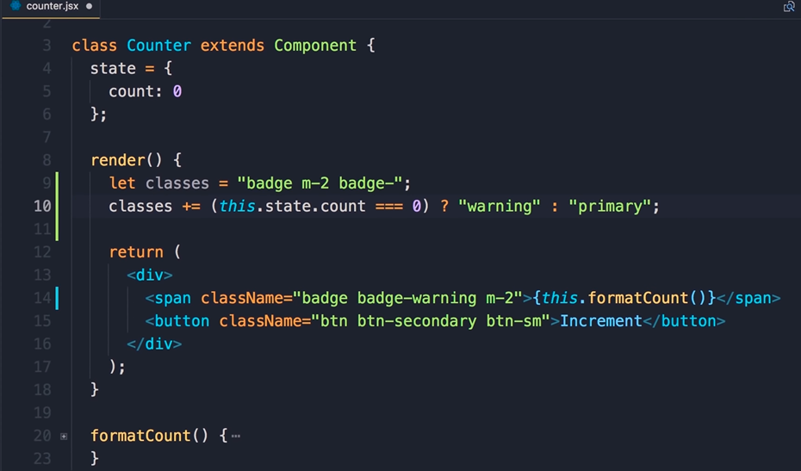

Slide 10
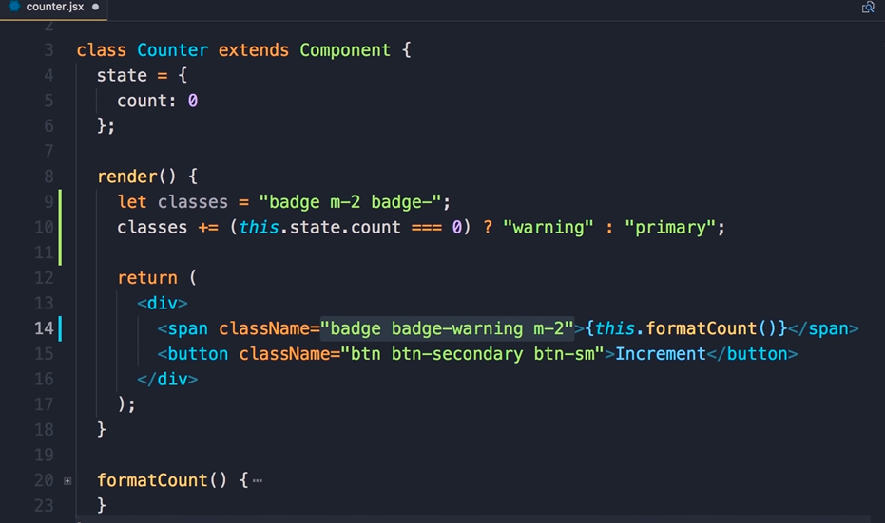

Slide 11
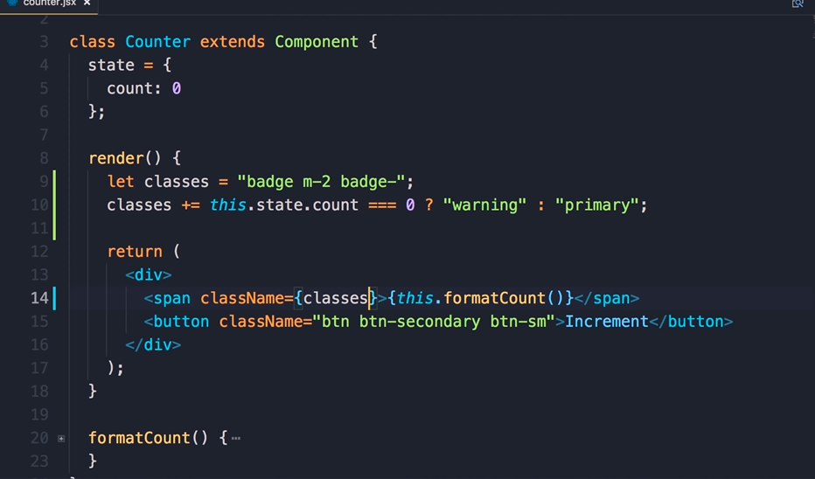

Slide 12
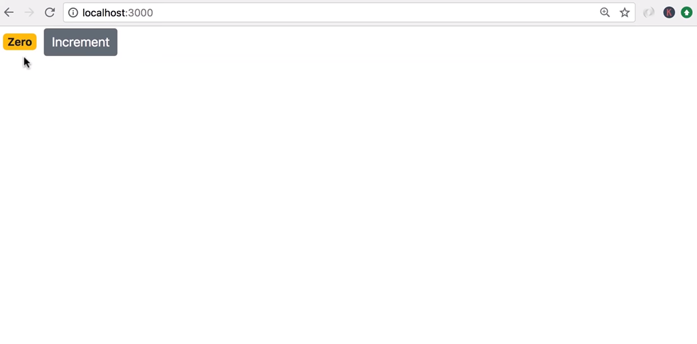

Slide 13
note that we're modifying this so we cannot use a constant that's when we use the let
keyword so if this that state that count equals zero we're gonna append badge -warning otherwise we're gonna append badge - primary now we could make this a little bit cleaner so we don't want to repeat badge - in a couple of places we can add that here badge - and here on line 10 simply append warning or primary
and finally replace these hard-coded classes with what we have in this variable so save the changes

Slide 14
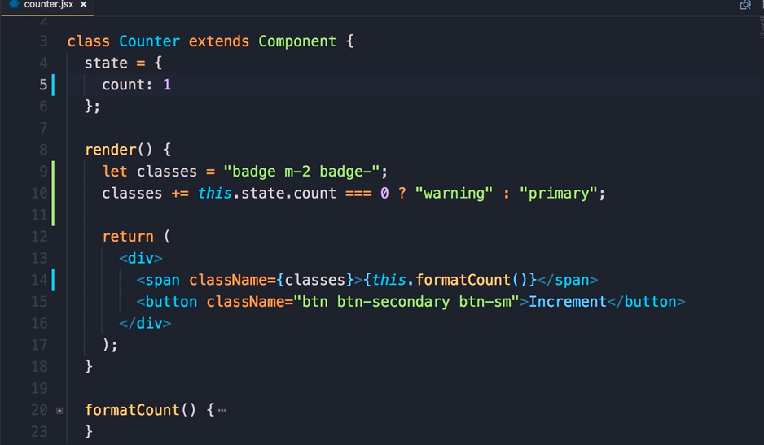

Slide 15
initially our count is zero that's why we have a yellow badge but if we go back here and change the value of count to 1 save the changes now we get a blue batch

Slide 16
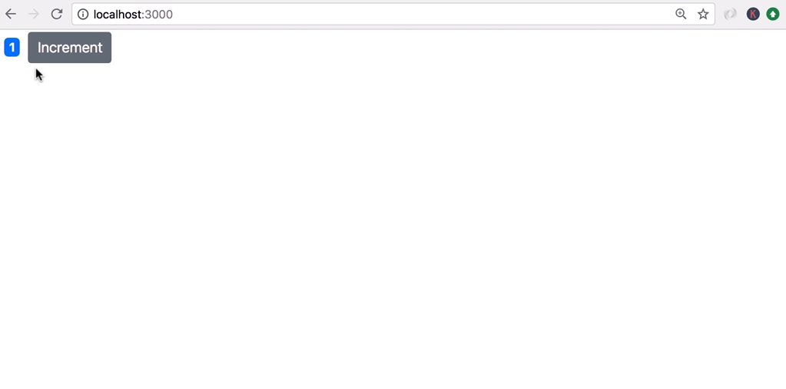

Slide 17
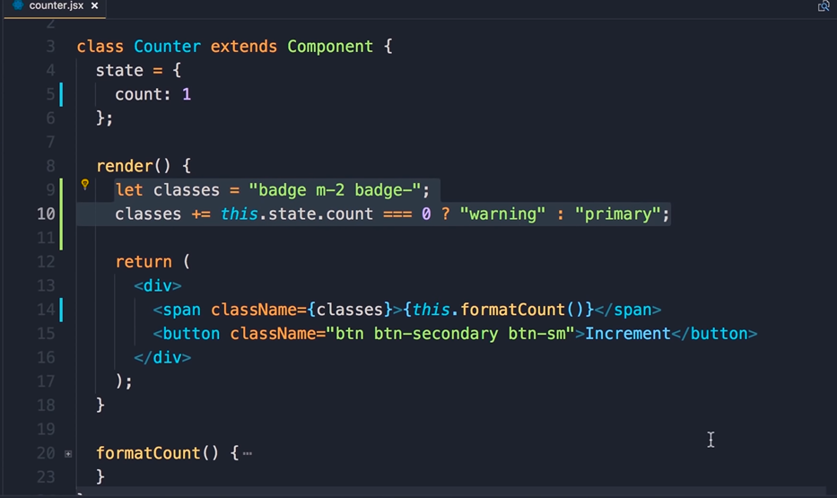

Slide 18
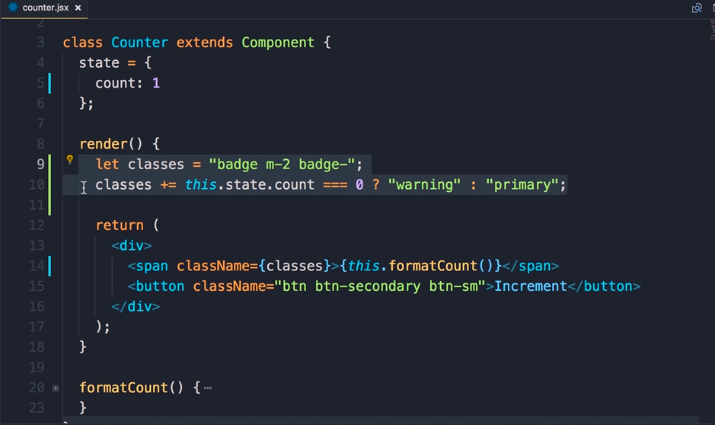

Slide 19
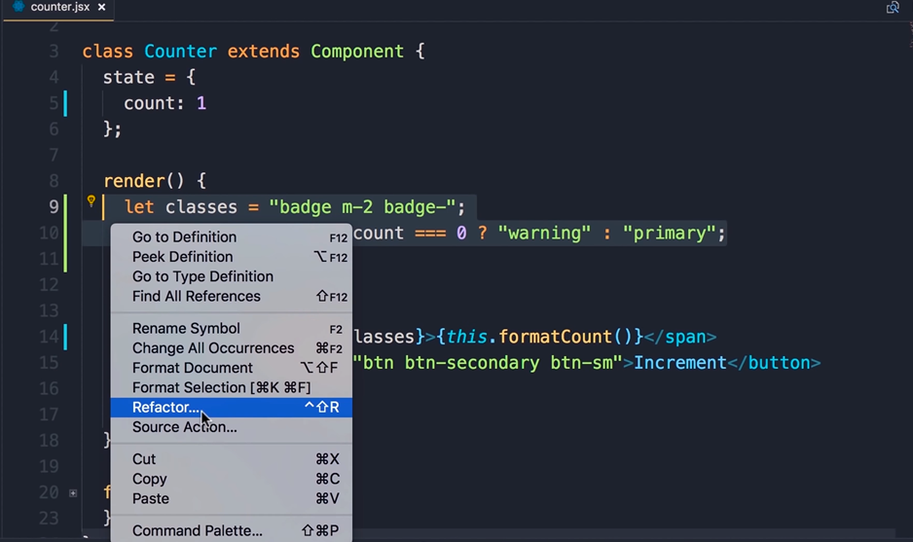

Slide 20
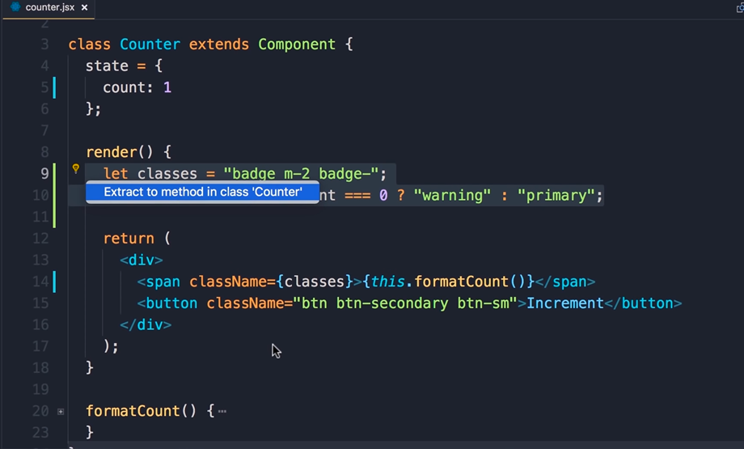

Slide 21
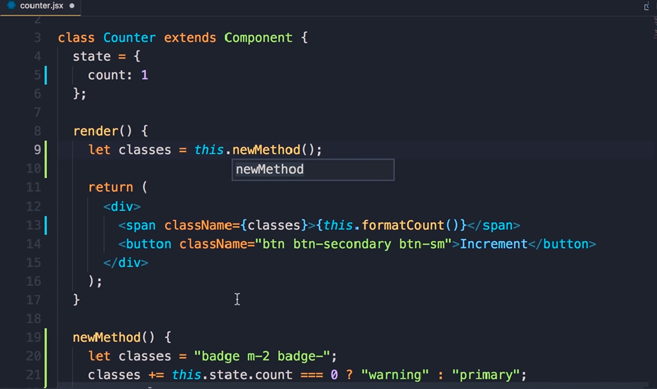

Slide 22
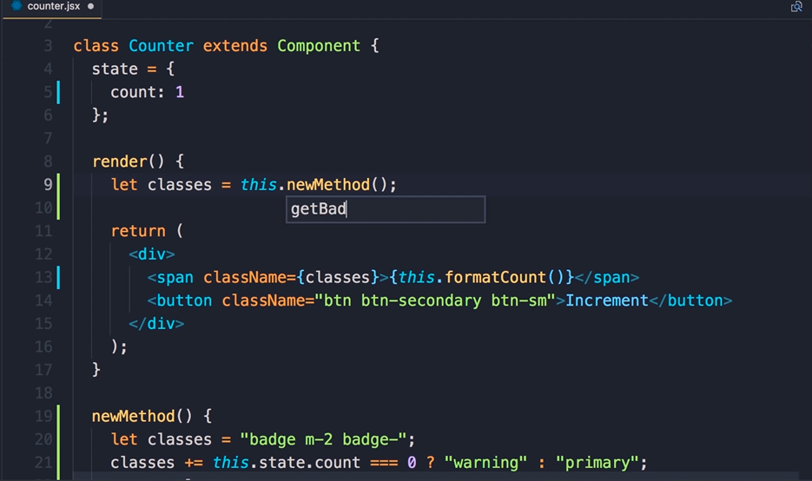

Slide 23
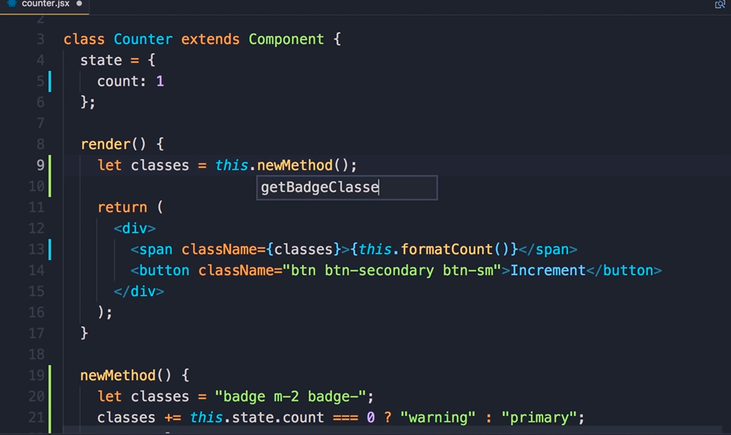

Slide 24
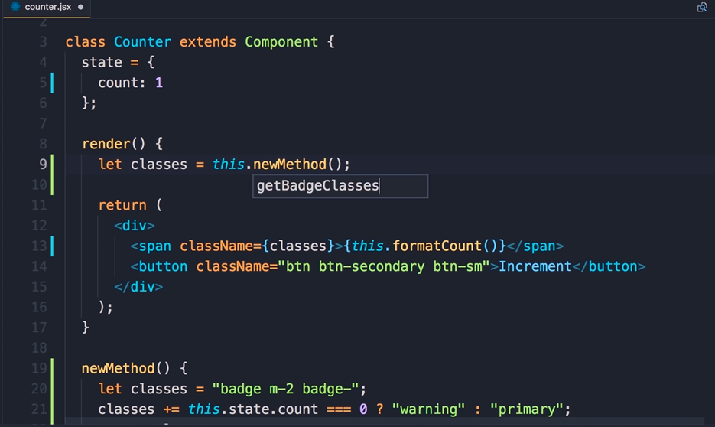

Slide 25
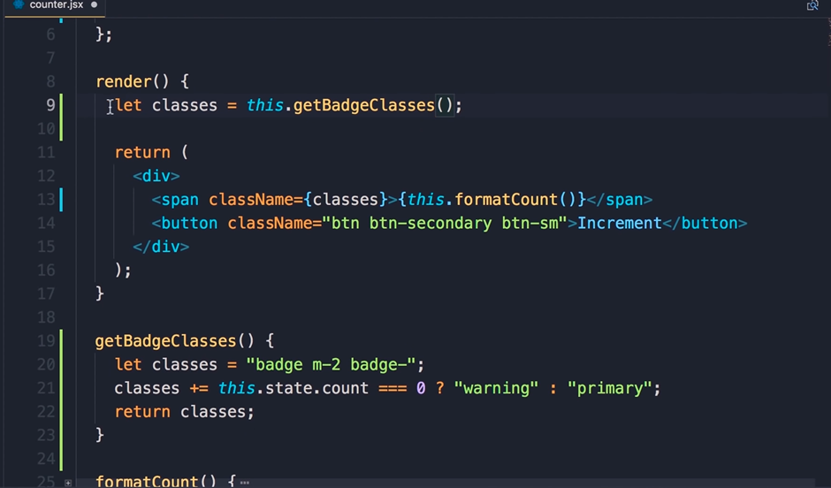

Slide 26
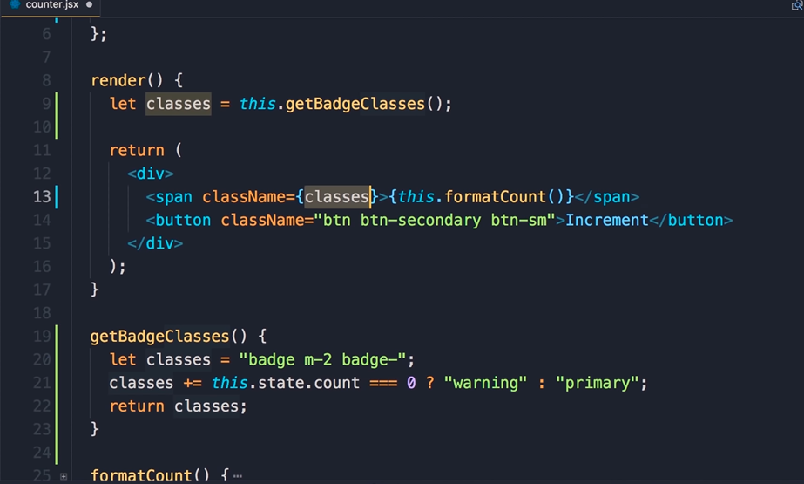

Slide 27
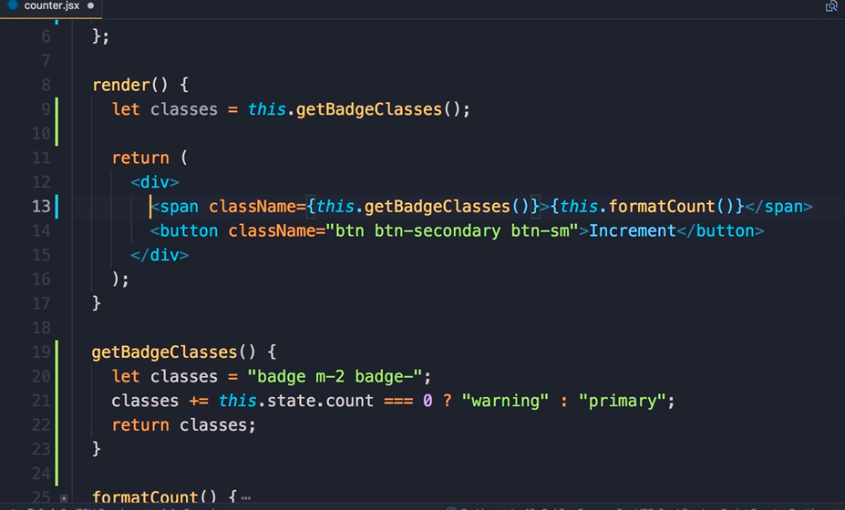

Slide 28
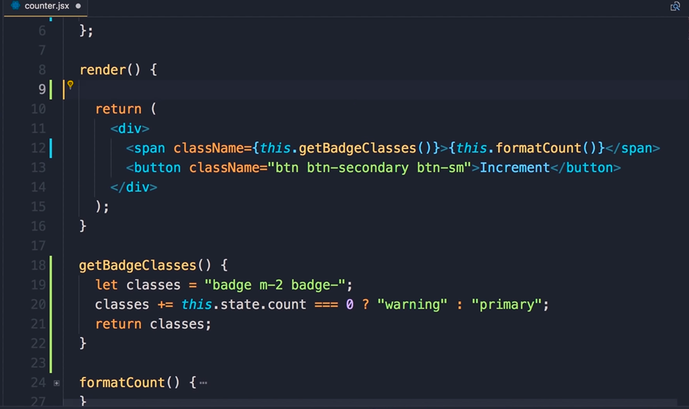

Slide 29
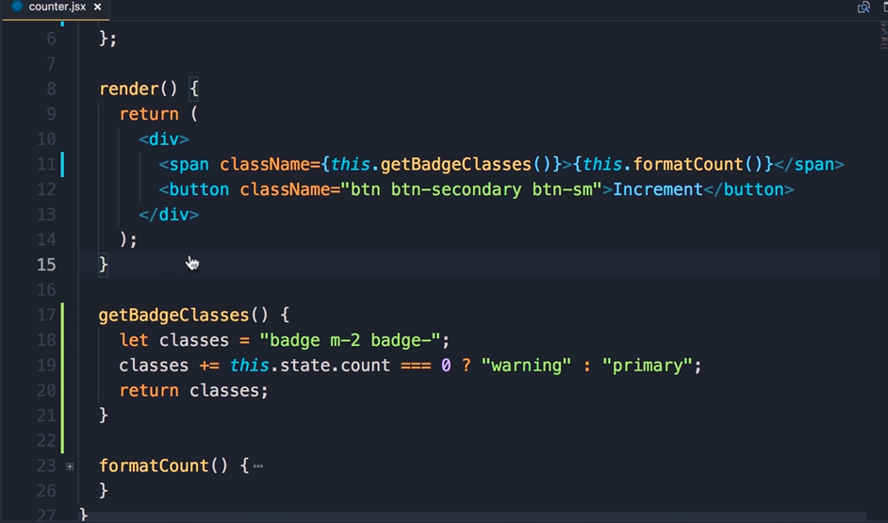

Slide 30
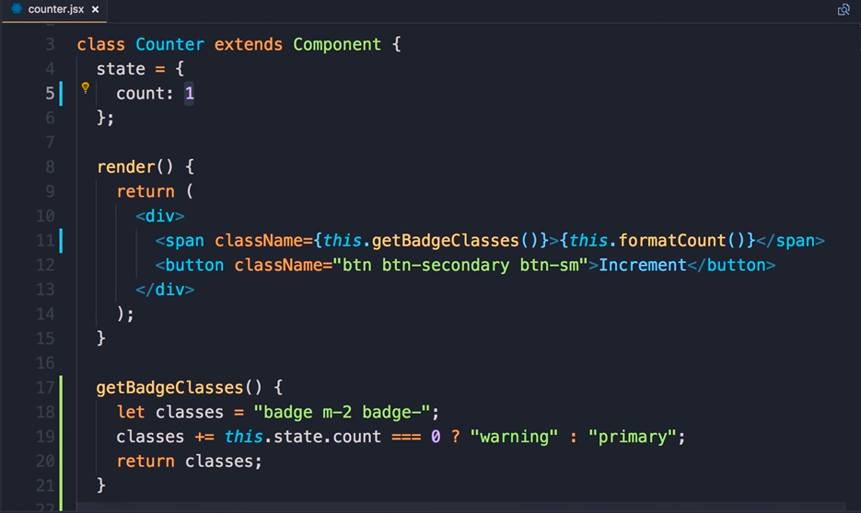

Slide 31
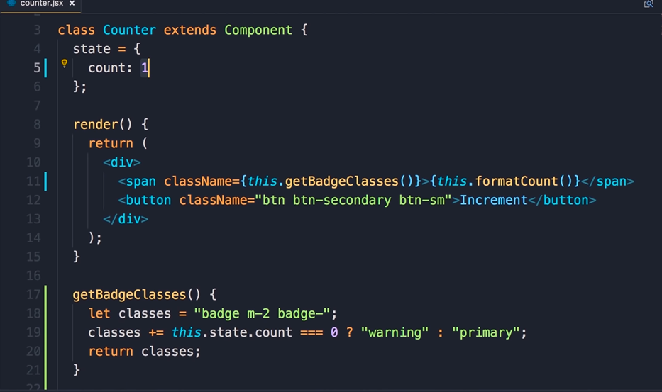

Slide 32
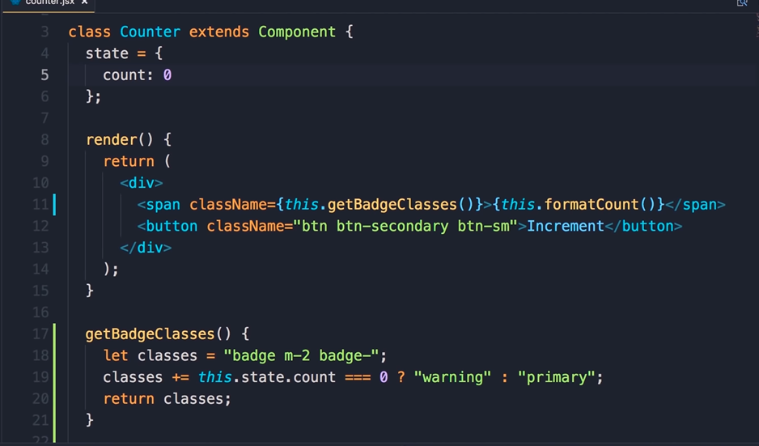

Slide 33
